Slide 1

JavaScript, Sixth Edition
Chapter 2
Working with Functions, Data Types, and Operators

Slide 2
Objectives
When you complete this chapter, you will be able to:
Use functions to organize your JavaScript code
Use expressions and operators
Identify the order of operator precedence in an expression
JavaScript, Sixth Edition

Slide 3
Working with Functions
Methods
  Procedures associated with an object
Functions
  Related group of JavaScript statements
  Executed as a single unit
  Virtually identical to methods
    Not associated with an object
  Must be contained within a script element
JavaScript, Sixth Edition

Slide 4
Defining Functions
Named function
  Related statements assigned a name
  Call, or reference, named function to execute it
Anonymous function
  Related statements with no name assigned
  Work only where they are located in code
Use named function when you want to reuse code
Use anonymous function for code that runs only once
JavaScript, Sixth Edition

Slide 5
Defining Functions (cont'd.)
Function definition
  Lines making up a function
Named function syntax
    function name_of_function(parameters) {
    statements;
    }
Anonymous function syntax
    function (parameters) {
    statements;
    }
JavaScript, Sixth Edition

Slide 6
Defining Functions (cont'd.)
Parameter
  Variable used within a function
  Placed within parentheses following a function name
  Multiple parameters allowed
    calculateVolume(length, width, height)
JavaScript, Sixth Edition

Slide 7
Defining Functions (cont'd.)
Function statements
  Do the actual work
  Contained within function braces
Put functions in an external .js file
  Reference at bottom of body section
function calculateVolume(length, width, height) {
  var volume = length * width * height;
  document.write(volume);
}
JavaScript, Sixth Edition

Slide 8
Calling Functions
To execute a named function:
  Must invoke, or call, it
Function call
  Code calling a function
  Consists of function name followed by parentheses
    Contains any variables or values assigned to the function parameters
Arguments (actual parameters)
  Variables (values) placed in the function call statement parentheses
JavaScript, Sixth Edition

Slide 9
Calling Functions (cont'd.)
Passing arguments
  Sending arguments to parameters of a called function
    Argument value assigned to the corresponding parameter value in the function definition
JavaScript, Sixth Edition

Slide 10
Calling Functions (cont'd.)
Handling events
  Three options
    Specify function as value for HTML attribute
    <input type="submit" onclick="showMessage()" />
    Specify function as property value for object
    document.getElementById("submitButton").onclick =↵ showMessage;
    Use addEventListener() method
    var submit = document.getElementById("submitButton");
    submit.addEventListener("click", showMessage, false);
JavaScript, Sixth Edition

Slide 11
Calling Functions (cont'd.)
Adding an event listener is most flexible
  Separates HTML and JavaScript code
  Can specify several event handlers for a single event
IE8 requires use of the attachEvent() method instead of addEventListener() (see Chapter 3)
JavaScript, Sixth Edition

Slide 12
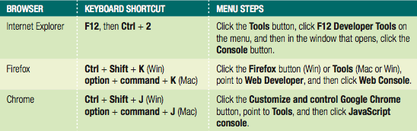
Locating Errors with the Browser Console
Unintentional coding mistakes keep code from working
  Browsers generate error messages in response
  Messages displayed in browser console pane
  Hidden by default to avoid alarming users
Developers display browser console to see errors
JavaScript, Sixth Edition

Slide 13
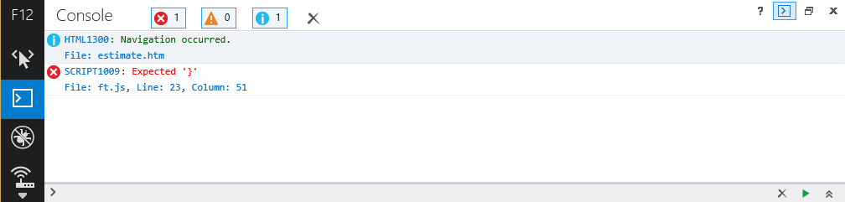
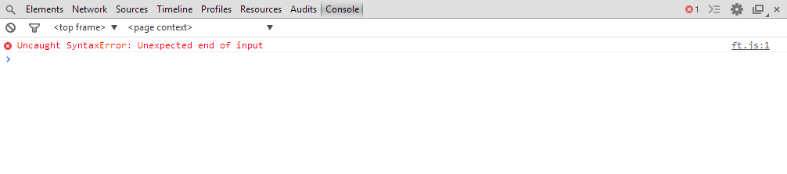
Locating Errors with the Browser Console (cont'd.)
Consoles specify a line number with each error
Figure 2-3: Internet Explorer browser console
Figure 2-4: Chrome browser console
JavaScript, Sixth Edition

Slide 14
Using Return Statements
Can return function value to a calling statement
Return statement
  Returns a value to the statement calling the function
  Use the return keyword with the variable or value to send to the calling statement
Example:
function averageNumbers(a, b, c) {
var sum_of_numbers = a + b + c;
var result = sum_of_numbers / 3;
^{return result;}
}
JavaScript, Sixth Edition

Slide 15
Understanding Variable Scope
Variable scope
  Where in code a declared variable can be used
Global variable
  Declared outside a function
    Available to all parts of code
Local variable
  Declared inside a function
    Only available within the function in which it is declared
  Cease to exist when the function ends
  Keyword var required
JavaScript, Sixth Edition

Slide 16
Understanding Variable Scope (cont’d.)
Good programming technique
  Always use the var keyword when declaring variables
    Clarifies where and when variable used
Poor programming technique
  Declaring a global variable inside of a function by not using the var keyword
    Harder to identify global variables in your scripts
JavaScript, Sixth Edition

Slide 17
Understanding Variable Scope (cont’d.)
If variable declared within a function and does not include the var keyword
  Variable automatically becomes a global variable
Program may contain global and local variables with the same name
  Local variable takes precedence
  Value assigned to local variable of the same name
    Not assigned to global variable of the same name
JavaScript, Sixth Edition

Slide 18
Understanding Variable Scope (cont’d.)
^{var color = "green";}
function duplicateVariableNames() {
^{var color = "purple";}
^{document.write(color);}
^{// value printed is purple}
}
^{duplicateVariableNames();}
^{document.write(color);}
^{// value printed is green}
JavaScript, Sixth Edition

Slide 19
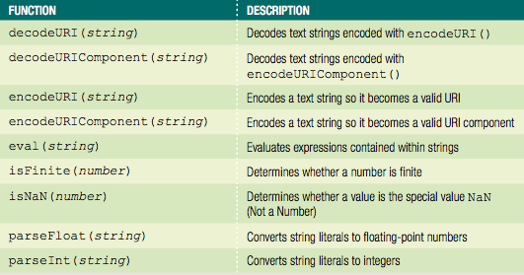
Using Built-in JavaScript Functions
Called the same way a custom function is called
Table 2-2 Built-in JavaScript functions
JavaScript, Sixth Edition

Slide 20
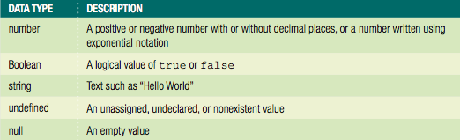
Working with Data Types
Data type
  Specific information category a variable contains
Primitive types
  Data types assigned a single value
Table 2-3 Primitive JavaScript data types
JavaScript, Sixth Edition

Slide 21
Working with Data Types (cont’d.)
The null value: data type and a value
  Can be assigned to a variable
  Indicates no usable value
  Use: ensure a variable does not contain any data
Undefined variable
  Never had a value assigned to it, has not been declared, or does not exist
  Indicates variable never assigned a value: not even null
  Use: determine if a value being used by another part of a script
JavaScript, Sixth Edition

Slide 22

Working with Data Types (cont’d.)
^{var stateTax;}
^{document.write(stateTax);}
^{stateTax = 40;}
^{document.write(stateTax);}
^{stateTax = null;}
^{document.write(stateTax);}
Figure 2-7 Variable assigned values of undefined and null
JavaScript, Sixth Edition

Slide 23
Working with Data Types (cont’d.)
Strongly typed programming languages
  Require declaration of the data types of variables
  Strong typing also known as static typing
    Data types do not change after declared
Loosely typed programming languages
  Do not require declaration of the data types of variables
  Loose typing also known as dynamic typing
    Data types can change after declared
JavaScript, Sixth Edition

Slide 24
Working with Data Types (cont’d.)
JavaScript interpreter automatically determines data type stored in a variable
Examples:
diffTypes = "Hello World"; // String
diffTypes = 8; // Integer number
diffTypes = 5.367; // Floating-point number
diffTypes = true; // Boolean
diffTypes = null; // Null
JavaScript, Sixth Edition

Slide 25
Understanding Numeric Data Types
JavaScript supports two numeric data types
  Integers and floating-point numbers
Integer
  Positive or negative number with no decimal places
Floating-point number
  Number containing decimal places or written in exponential notation
  Exponential notation (scientific notation)
    Shortened format for writing very large numbers or numbers with many decimal places
JavaScript, Sixth Edition

Slide 26
Using Boolean Values
Logical value of true or false
  Used for decision making
    Which parts of a program should execute
  Used for comparing data
JavaScript programming Boolean values
  The words true and false
    JavaScript converts true and false values to the integers 1 and 0 when necessary
JavaScript, Sixth Edition

Slide 27

Using Boolean Values (cont’d.)
^{1 var newCustomer = true;}
^{2 var contractorRates = false;}
3 document.write("<p>New customer: " + newCustomer + "</p>");
4 document.write("<p>Contractor rates: " + contractorRates +↵
^{5 "</p>");}
Figure 2-9 Boolean values
JavaScript, Sixth Edition

Slide 28
Working with Strings
Text string
  Contains zero or more characters
    Surrounded by double or single quotation marks
  Can be used as literal values or assigned to a variable
Empty string
  Zero-length string value
  Valid for literal strings
    Not considered to be null or undefined
JavaScript, Sixth Edition

Slide 29
Working with Strings (cont’d.)
To include a quoted string within a literal string surrounded by double quotation marks
  Surround the quoted string with single quotation marks
To include a quoted string within a literal string surrounded by single quotation marks
  Surround the quoted string with double quotation marks
String must begin and end with the same type of quotation marks
JavaScript, Sixth Edition

Slide 30
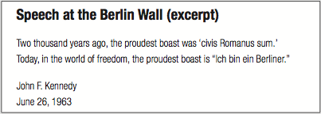
Working with Strings (cont’d.)
document.write("<h1>Speech at the Berlin Wall↵
^{(excerpt)</h1>");}
document.write("<p>Two thousand years ago, the proudest boast↵
was 'civis Romanus sum.'<br />");
document.write('Today, in the world of freedom, the proudest↵
boast is "Ich bin ein Berliner."</p>');
var speaker = "<p>John F. Kennedy</br>";
var date = 'June 26, 1963</p>';
^{document.write(speaker);}
^{document.write(date);}
Figure 2-10 String examples in a browser
JavaScript, Sixth Edition

Slide 31
Working with Strings (cont’d.)
String operators
  Concatenation operator (+): combines two strings
    ^{var destination = "Honolulu";}
    ^{var location = "Hawaii";}
    destination = destination + " is in " + location;
Compound assignment operator (+=): combines two strings
    ^{var destination = "Honolulu";}
    destination += " is in Hawaii";
Plus sign
  Concatenation operator and addition operator
JavaScript, Sixth Edition

Slide 32
Working with Strings (cont’d.)
Escape characters and sequences
  Escape character
    Tells the compiler or interpreter that the character that follows has a special purpose
    In JavaScript, escape character is backslash (\)
  Escape sequence
    Escape character combined with other characters
    Most escape sequences carry out special functions
JavaScript, Sixth Edition

Slide 33
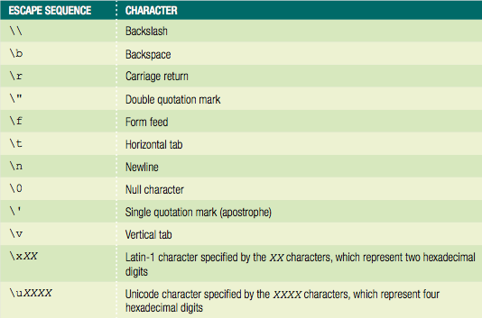
Working with Strings (cont’d.)
Table 2-4 JavaScript escape sequences
JavaScript, Sixth Edition

Slide 34
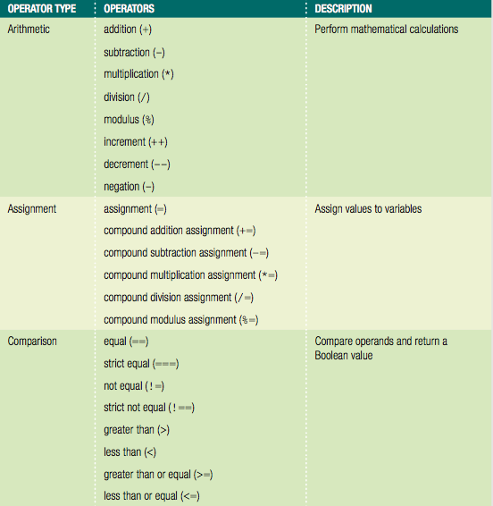
Using Operators to Build Expressions
Table 2-5 JavaScript operator types (continues)
JavaScript, Sixth Edition

Slide 35
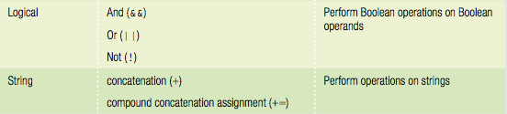
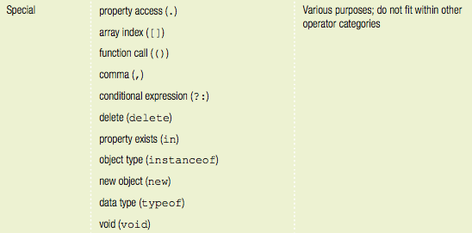
Using Operators to Build Expressions (cont’d.)
Table 2-5 JavaScript operator types (cont'd.)
JavaScript, Sixth Edition

Slide 36
Using Operators to Build Expressions (cont’d.)
Binary operator
  Requires an operand before and after the operator
Unary operator
  Requires a single operand either before or after the operator
JavaScript, Sixth Edition

Slide 37
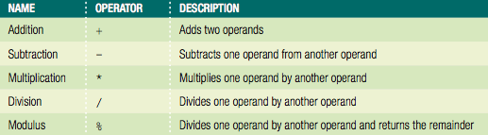
Arithmetic Operators
Perform mathematical calculations
  Addition, subtraction, multiplication, division
  Returns the modulus of a calculation
Arithmetic binary operators
Table 2-6 Arithmetic binary operators
JavaScript, Sixth Edition

Slide 38
Arithmetic Operators (cont’d.)
Arithmetic binary operators (cont’d.)
  Value of operation on right side of the assignment operator assigned to variable on the left side
  Example: arithmeticValue = x + y;
    Result assigned to the arithmeticValue variable
  Division operator (/)
    Standard mathematical division operation
  Modulus operator (%)
    Returns the remainder resulting from the division of two integers
JavaScript, Sixth Edition

Slide 39

Arithmetic Operators (cont’d.)
^{var divisionResult = 15 / 6;}
^{var modulusResult = 15 % 6;}
document.write("<p>15 divided by 6 is "↵
+ divisionResult + ".</p>"); // prints '2.5'
document.write("<p>The whole number 6 goes into 15 twice,↵
with a remainder of "+ modulusResult + ".</p>");↵ // prints '3'
Figure 2-13 Division and modulus expressions
JavaScript, Sixth Edition

Slide 40
Arithmetic Operators (cont’d.)
Arithmetic binary operators (cont’d.)
  Assignment statement
    Can include combination of variables and literal values on the right side
    Cannot include a literal value as the left operand
  JavaScript interpreter
    Attempts to convert the string values to numbers
    Does not convert strings to numbers when using the addition operator
JavaScript, Sixth Edition

Slide 41

Arithmetic Operators (cont’d.)
Prefix operator
  Placed before a variable
Postfix operator
  Placed after a variable
Table 2-7 Arithmetic unary operators
JavaScript, Sixth Edition

Slide 42
Arithmetic Operators (cont’d.)
Arithmetic unary operators
  Performed on a single variable using unary operators
  Increment (++) unary operator: used as prefix operators
    Prefix operator placed before a variable
  Decrement (--) unary operator: used as postfix operator
    Postfix operator placed after a variable
  Example: ++count; and count++;
    Both increase the count variable by one, but return different values
JavaScript, Sixth Edition

Slide 43
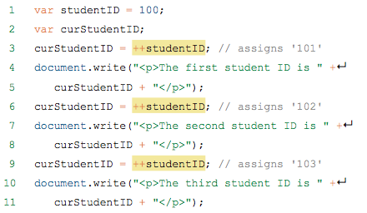

Arithmetic Operators (cont’d.)
Figure 2-14 Output of the prefix version of the student ID script
JavaScript, Sixth Edition

Slide 44

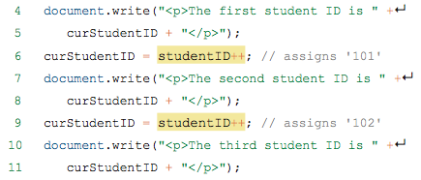

Arithmetic Operators (cont’d.)
Figure 2-15 Output of the postfix version of the student ID script
JavaScript, Sixth Edition

Slide 45
Assignment Operators
Used for assigning a value to a variable
Equal sign (=)
  Assigns initial value to a new variable
  Assigns new value to an existing variable
Compound assignment operators
  Perform mathematical calculations on variables and literal values in an expression
    Then assign a new value to the left operand
JavaScript, Sixth Edition

Slide 46
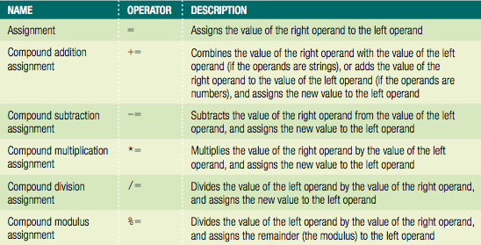
Assignment Operators (cont’d.)
Table 2-8 Assignment operators
JavaScript, Sixth Edition

Slide 47
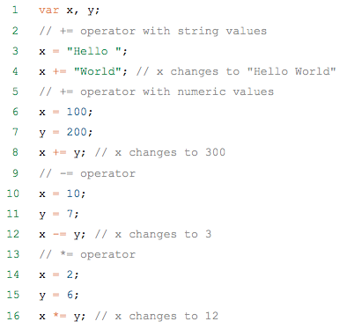
Assignment Operators (cont’d.)
+= compound addition assignment operator
  Used to combine two strings and to add numbers
Examples:
JavaScript, Sixth Edition

Slide 48
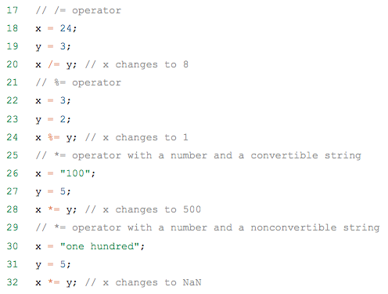
Assignment Operators (cont’d.)
Examples: (cont’d.)
JavaScript, Sixth Edition

Slide 49
Comparison and Conditional Operators
Comparison operators
  Compare two operands
    Determine if one numeric value is greater than another
  Boolean value of true or false returned after compare
Operands of comparison operators
  Two numeric values: compared numerically
  Two nonnumeric values: compared in alphabetical order
  Number and a string: convert string value to a number
    If conversion fails: value of false returned
JavaScript, Sixth Edition

Slide 50
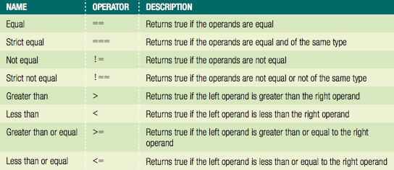
Comparison and Conditional Operators (cont’d.)
Table 2-9 Comparison operators
JavaScript, Sixth Edition

Slide 51
Comparison and Conditional Operators (cont’d.)
Conditional operator
  Executes one of two expressions based on conditional expression results
  Syntax
    conditional expression ? expression1 : expression2;
  If conditional expression evaluates to true:
    Then expression1 executes
  If the conditional expression evaluates to false:
    Then expression2 executes
JavaScript, Sixth Edition

Slide 52
Comparison and Conditional Operators (cont’d.)
Example of conditional operator:
^{var intVariable = 150;}
^{var result;}
^{intVariable > 100 ?↵}
result = "intVariable is greater than 100" :↵
result = "intVariable is less than or equal to 100";
^{document.write(result);}
JavaScript, Sixth Edition

Slide 53
Falsy and Truthy Values
Six falsy values treated like Boolean false:
  ""
  -0
  0
  NaN
  null
  undefined
All other values are truthy, treated like Boolean true
JavaScript, Sixth Edition

Slide 54
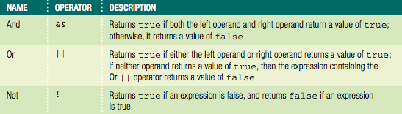
Logical Operators
Compare two Boolean operands for equality
Table 2-10 Logical operators
JavaScript, Sixth Edition

Slide 55
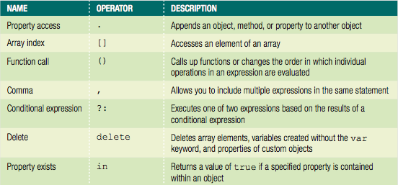
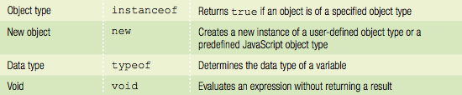
Special Operators
Table 2-11 Special operators
JavaScript, Sixth Edition

Slide 56
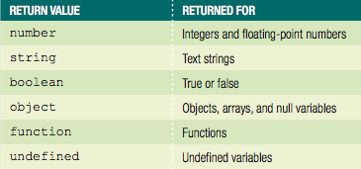
Special Operators (cont’d.)
Table 2-12 Values returned by typeof operator
JavaScript, Sixth Edition

Slide 57
Understanding Operator Precedence
Operator precedence
  Order in which operations in an expression evaluate
Associativity
  Order in which operators of equal precedence execute
  Left to right associativity
  Right to left associativity
JavaScript, Sixth Edition

Slide 58
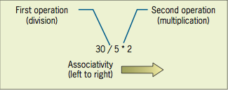
Understanding Operator Precedence (cont’d.)
Evaluating associativity
  Example: multiplication and division operators
    Associativity of left to right
Figure 2-16 Conceptual illustration of left to right associativity
JavaScript, Sixth Edition

Slide 59
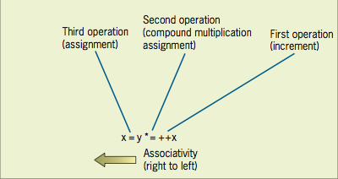
Understanding Operator Precedence (cont’d.)
Evaluating associativity (cont’d.)
  Example: Assignment operator and compound assignment operators
    Associativity of right to left
    x = y *= ++x
^{var x = 3;}
^{var y = 2;}
^{x = y *= ++x;}
Figure 2-17 Conceptual illustration of right-to-left associativity
JavaScript, Sixth Edition

Slide 60
Summary
Functions
  Similar to methods associated with an object
  Pass parameters
  To execute, must be called
Variable scope
  Where a declared variable can be used
  Global and local variables
Data type
  Specific category of information a variable contains
  Static typing and dynamic typing
JavaScript, Sixth Edition

Slide 61
Summary (cont’d.)
Numeric data types: integer and floating point
Boolean values: true and false
Strings: one or more character surrounded by double or single quotes
  String operators
  Escape character
Operators build expressions
Operator precedence
  Order in which operations in an expression are evaluated
JavaScript, Sixth Edition

